Slide 1

SIR C R REDDY COLLEGE OF ENGINEERING
Dept. of ELECTRONICS & COMMUNICATION ENGINEERING
GUIDE:
K . Lakshminarayana M.Tech,( Ph.D)
PROJECT MEMBERS:
G. Naga Jyothi-19B81A0452
A. Anil -20B85A0401
B. Nanda Kishore sai-20B85A0402 A.Naveena-19B81A0406
CH.Vamsi-19B81A0432
PROJECT COORDINATORS:
M. Greeshma M.Tech
P . Srinivasulu M.Tech

Slide 2
AUTOMATIC BORDER CROSSING DETECTION AND NAVIGATION FOR FISHING VESSELS

Slide 3
CONTENTS
Abstract
Introduction
Problem definition
Literature survey
Field survey
Existing model
Proposed model
Block diagram
Methodology
Components/Tools
Hardware implementation
Results
Advantages and applications
conclusion
Reference papers

Slide 4
ABSTRACT
Fishermen's livelihoods are so insecure that if they cross the country's border accidently, it is treated as a serious offence. The severity of the situation seems to worsen when impoverished fisherman are shot and their boats are taken. The fundamental cause of this problem is that marine borders between countries are difficult to identify. The term "maritime border alert system" refers to a system that assists fishermen by informing them of the country's border while protecting them and their boats. Technology such as global navigation satellite system (GPS), universal mobile telecommunications network (GSM) are used to achieve this purpose. The proposed framework includes a low-cost maritime boundary crossing warning system for fishermen.

Slide 5
INTRODUCTION
Fishing is the main livelihood for most of the people in India but due to a lack of proper knowledge about the international borders of other countries and lack of proper technical equipment and technical support they are unknowingly entering into the neighbouring country borders and has been arrested and shot dead by the naval forces for the fault they don’t know about by this they are losing their lives and leaving their families on the roads, So to save their lives and their families we designed an application which gives an alert by making buzzer sound before entering into the borders of another country by tracking the location of the boat with help of GPS module and then sends the SMS alert to coastal guards and fisherman by making use of GSM module if they enter by ignoring the alerts the application will automatically guide the boat into Indian borders and saves their lives. This would tremendously aid the underprivileged and defenceless fishermen in continuing to operate within Indian boundaries.

Slide 6
PROBLEM DEFINITION
There has been several cases where the ignorant and poor fishermen are unknowingly and due to lack of technical equipment and knowledge have crossed the international border of sea, and has been arrested by other country naval forces on the accusation of terrorism . These innocent fishermen with no fault of theirs get caught and get severe punishment for the fault they don’t know about. Countries with the International Marine time Boundary Line(IMBL) will always have security problems and continuous life threatens for those fishermen whose family’s main economic support is fishing. In the peninsular country like India has their boundary limit in the ocean, the people of these coastal regions has the main work of fishing, due to carelessness or without knowing their boundary limit of their country they cross the borders. So in order o solve this problem, our group took this as a challenge and we have found an easy and feasible way to solve this problem in which the fishermen would be given certain signals and a buzzer would sound as soon as they approach the border and thus they can remain at safe distance from the border. This would greatly help the poor and innocent fishermen to remain within the Indian borders and continue their work.

Slide 7
LITERATURE SURVEY
ARUNVIJAY et al “DESIGN OF BORDER ALERT SYSTEM FORFISHERMEN USING GPS”, MARCH 2014
In this method, the author uses the pre-determined values of latitude and longitude points of the maritime border shown in the fig this is stored in the microcontroller. When the boat approaches the border, boats position (latitude and longitude) is measured using GPS and compared with the stored value, if it exceeds then the boats seems to be crossed and alert message is sent to the fisherman. The advantage is accuracy range is high with the use of GPS.but the drawback is the memory required saving each point of latitude and longitude is more.

Slide 8
LITERATURE SURVEY
VIGNESH M et al, “GPS BASED BORDER ALERT SYSTEM FOR FISHERMEN WITH BOAT SPEEDOMETER”, MARCH 2015
In this method the author foresee the use of GPS tracking system. The boats position is measured using GPS and the speed of the boats motor is controlled in case of emergency. The alert message is sent to the user (fisherman) .The advantage is for the purpose of identification the fisherman are using the GPS72h, equipment used for the navigation in sea and it provides the fastest and most accurate method for mariner navigate, measure speed, and determines location and this system enables increased levels of safety and efficiency. The disadvantage here is that border alert is intimated only to the fishermen but not to the control station.

Slide 9
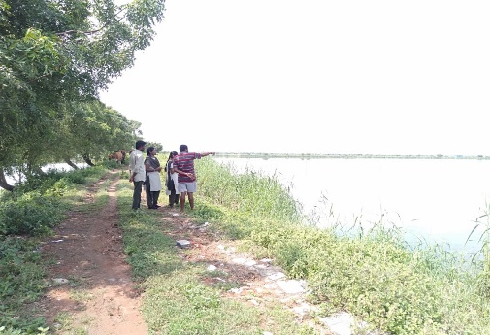
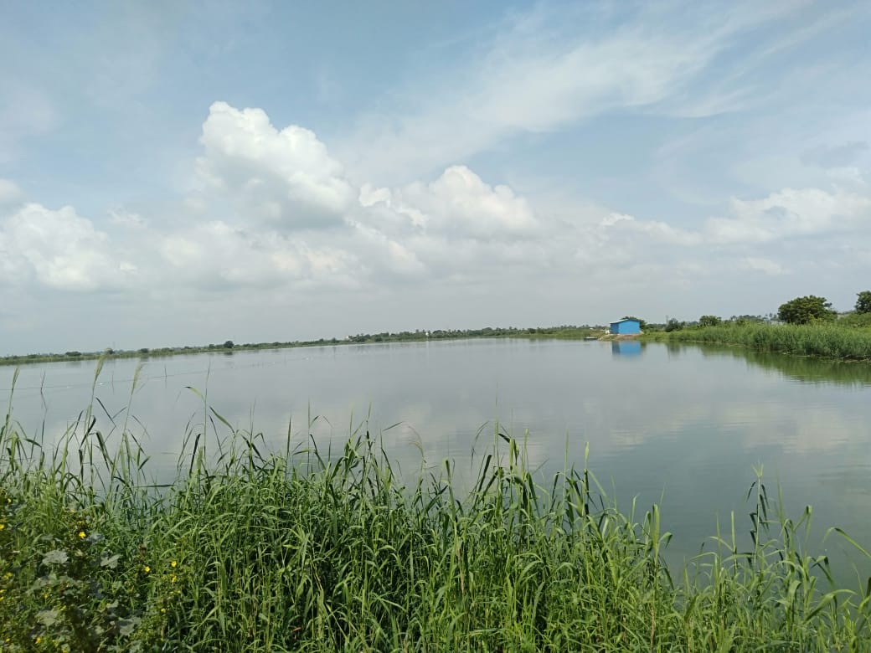
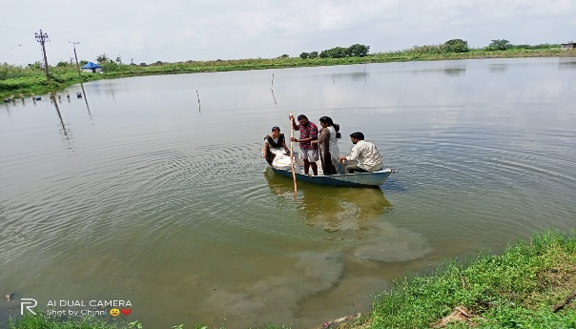
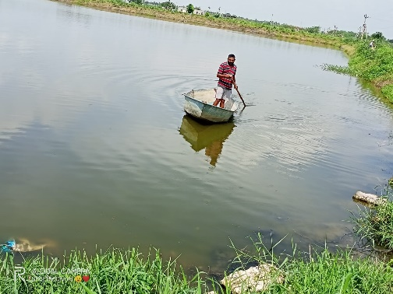
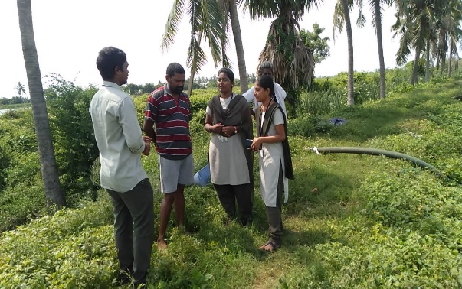
FIELD SURVEY

Slide 10
EXISTING MODEL
As there are several existing systems of border alert systems which identify the current position and coordinates using a GPS tracking system which gives only alerts to the fishermen inside guards but the guards are not in a position to take any action as they already entering into international borders and caught by the naval officers and being punished brutally and up to death too. And the existing model only allows starting and destination locations tracking this will become more critical to the system to identify the route that the boat is travelling and this will lead to accidents and even more difficulty to find the exact location whenever the boat/ship got missing and leads to huge losses like man and money.

Slide 11
PROPOSED MODEL
The proposed system uses a GPS receiver which receives a signal from the satellite and gives the current position of the boat. The proposed system is used to detect the border of the country through the specified longitude and latitude of the position, not only between Sri Lanka and India but all over the world. The particular layer level i.e. border can be predefined and this can be stored in memory. The current value is compared with predefined values and if these values are the same, immediately the particular operation will be done i.e, the Arduino gives instructions to the alarm to buzzer. It also uses a transmitter to send messages to the base station which monitors the boats in the sea. The system indicates both fishermen and coastal guards. Thus it saves the lives of the fisherman and alerts the base station to provide help.

Slide 12
PROPOSED MODEL
There are three different locations which are pre-stored those location points are just a few nautical miles away from the border at each location each warning system is proclaimed at the first location that will be a warning buzzer and there will be an exact display of the distance between the present location and border in SMS and also there is the reduction of boat speed if fishermen miss warning and he moved ahead then it shows distance information and also the motor will automatically navigate into Indian borders and the location of that point is send to the navy control room and they will come and verify the legitimacy of fishermen before crossing the border the and lives of fishermen are saved.

Slide 13
BLOCK DIAGRAM
12v battery
Power supply
Arduino
GPS
Gsm
DC Motor
Motor driver
Power supply
RF receiver
DC Motor
Buzzer
RF Transmitter

Slide 14
METHODOLOGY
The GPS device will continuously give the signal which determines the latitude and longitude and indicates the position of fishermen to them.
The global Positioning system (GPS) is a space-based satellite navigation system that provides location and time information in all weather conditions, anywhere on or near the Earth where there is an unobstructed line of sight to four or more GPS satellites.
GPS module communicates continuously with the satellite for getting the coordinates of a particular place. Then we need to send these coordinates from GPS to our Arduino by framing a proper Arduino code. The coordinates of all places are continuously monitored and as soon as border is reached the latitude is matched and a red light glows, a buzzer is sounded and a message is sent to registered mobile number stating Warning! Do Not Cross.

Slide 15
The proposed system uses a GPS receiver which receives signal from the satellite and gives the current position of the boat.
The proposed system is used to detect the border of the country through the specified longitude and latitude of the position, not only between Sri Lanka and India but all over the world.
The particular latitudes and longitudes i.e. border coordinates can be predefined and this can be stored in a microcontroller memory.
The current value is compared with predefined values and if these values are same, immediately the particular operation will be done i.e. the microcontroller gives the instruction to the alarm to buzzer.
It also uses a message transmitter to send message to the base station which monitors the boats in the sea. The system provides an indication to both the fishermen and to coast guard.

Slide 16
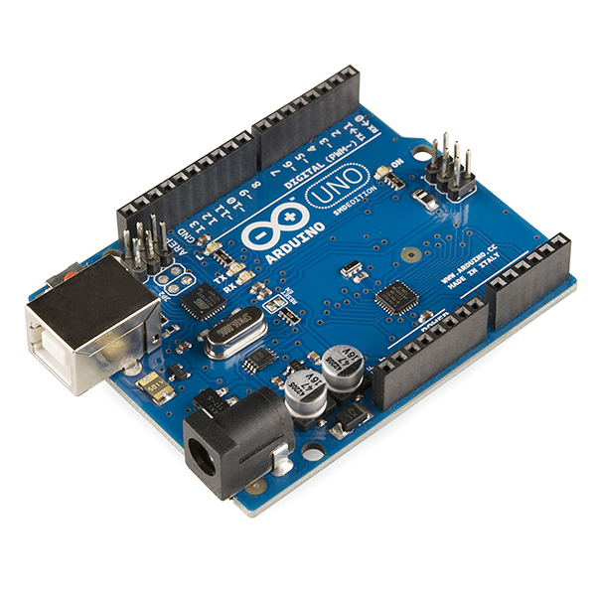
COMPONENTS/TOOLS
ARDUINO UNO
Microcontroller : ATmega328P
Operating Voltage : 5V
Recommended Input Voltage : 7-12V
Input Voltage Limits : 6 -20V
Analog Input Pins : 6(A0-A5)
Digital I/O Pins : 14 (6 provide PWM)
DC Current on I/O Pins : 40 mA
DC Current on 3.3V Pin : 50 mA
Flash Memory : 32 KB (0.5-KB Bootloader)
SRAM : 2 KB
EEPROM : 1 KB
Frequency (Clock Speed) : 16 MHz

Slide 17
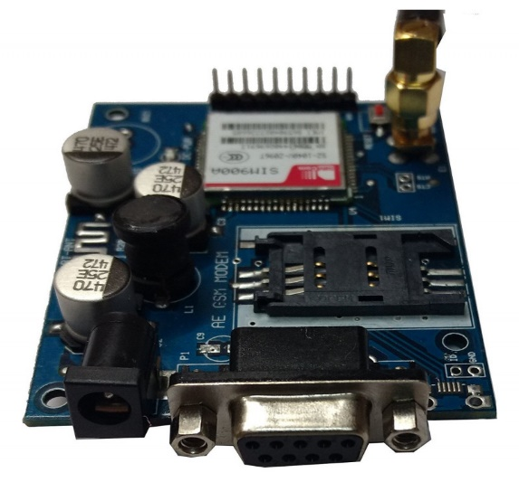
GSM MODULE:
Features and Specifications
Single supply voltage: 3.4V – 4.5V
Power saving mode: Typical power consumption in SLEEP mode is 1.5mA
Frequency bands:SIM900A Dual-band: EGSM900, DCS1800. ...
GSM class: Small MS
GPRS connectivity: GPRS multi-slot class 10 (default) , GPRS multi-slot class 8 (option)
Transmitting power: Class 4 (2W) at EGSM 900, Class 1 (1W) at DCS 1800
Operating Temperature: -30ºC to +80ºC
Storage Temperature: -5ºC to +90ºC

Slide 18
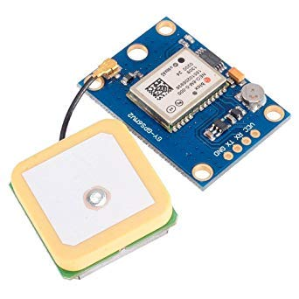
GPS MODULE
Global Positioning System (GPS) is a satellite-based system that uses satellites and ground stations to measure and compute its position on Earth.
GPS is also known as Navigation System with Time and Ranging (NAVSTAR) GPS.
GPS receiver needs to receive data from at least 4 satellites for accuracy purpose. GPS receiver does not transmit any information to the satellites.

Slide 19
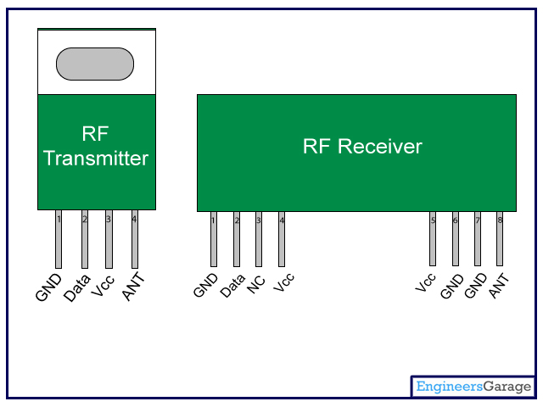
RF MODULE
In generally, the wireless systems designer has two overriding constraints: it must operate over a certain distance and transfer a certain amount of information within a data rate. The RF modules are very small in dimension
Specifications RF 433MHz Receiver
Frequency Range: 433.92 MHz
Modulation: ASK
Input Voltage: 5V
Specifications RF 433MHz Transmitter
Frequency Range: 433.92MHz
Input Voltage: 3-12V

Slide 20
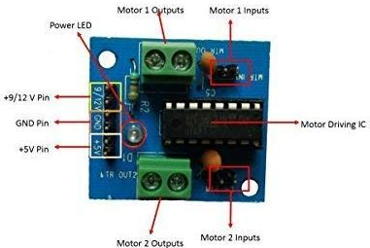
MOTOR DRIVER
L293D is a typical Motor driver or Motor Driver IC which allows DC motor to drive on either direction. L293D is a 16-pin IC which can control a set of two DC motors simultaneously in any direction. It means that you can control two DC motor with a single L293D IC. Dual H-bridge Motor Driver integrated circuit (IC).

Slide 21
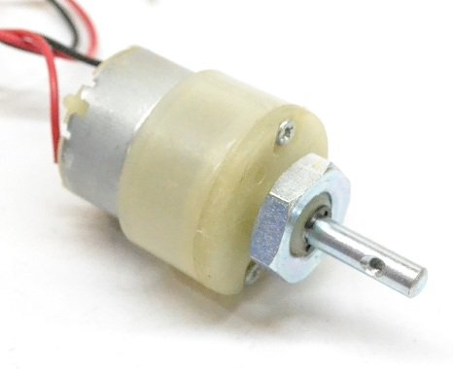
DC MOTOR
A machine that converts D.C power into mechanical power is known as a d.c. motor. Its operation is based on the principle that when a current carrying conductor is placed in a magnetic field, the conductor experiences a mechanical force. The direction of this force is given by Fleming’s left hand rule and magnitude is given by;
F = BIl newton’s
Basically, there is no constructional difference between a D.C. motor and a D.C. generator. The same D.C. machine can be run as a generator or motor.

Slide 22
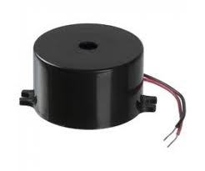
BUZZER
A buzzer or beeper is an audio signaling device, which may be mechanical, electromechanical, or piezoelectric. Typical uses of buzzers and beepers include alarm devices, timers and confirmation of user input such as a mouse click or keystroke. Buzzer is an integrated structure of electronic transducers, DC power supply, widely used in computers, printers, copiers, alarms, electronic toys, automotive electronic equipment, telephones, timers and other electronic products for sound devices. Active buzzer 5V Rated power can be directly connected to a continuous sound, this section dedicated sensor expansion module and the board in combination, can complete a simple circuit design, to "plug and play.

Slide 23
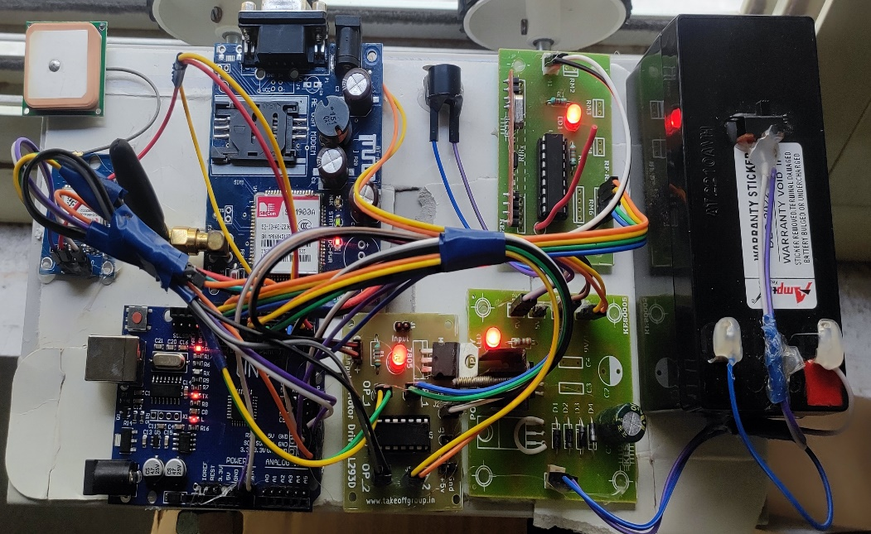
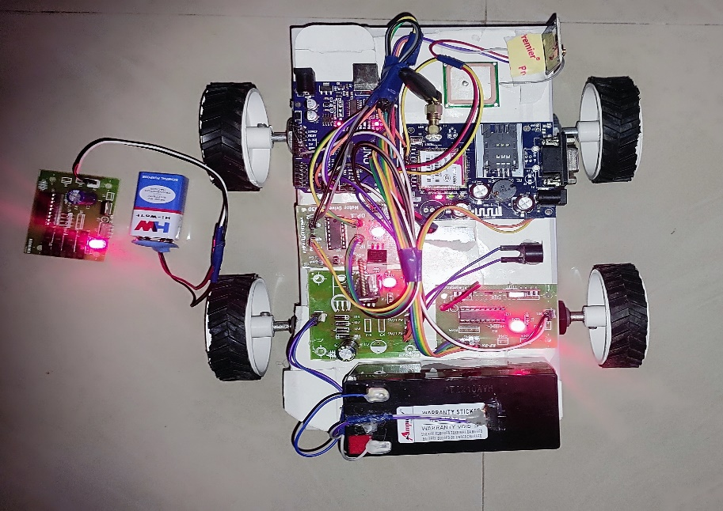
HARDWARE IMPLEMENTATION

Slide 24
The implementation of automatic border crossing detection and navigation for fishing vessels using above hardware prototype:
Input Stage: The input stage consists of battery power supply to power up the kit and to fetch and detect the latitudes and longitudes throug GPS module.
The predefined latitudes and longitudes are stored in the memory as a primary input.
Arduino is the heart of the system which receives coordinates through the GPS module and compare with predefined coordinates.when ever the fetched coordinates exceeds the predefined coordinates then the system enters into output stage.

Slide 25
Output Stage: The output stage includes various output devices such as buzzer whenever the coordinates exceeds the predefined coordinates the buzzer will go high and gives beep sound and an SMS alert along with the exact locations of the system has been sent to registered mobile number through GSM module.
Control stage: After all this the system automatically navigates and come back into our surroundings where the condition doesn’t exist without any human involvement.

Slide 26
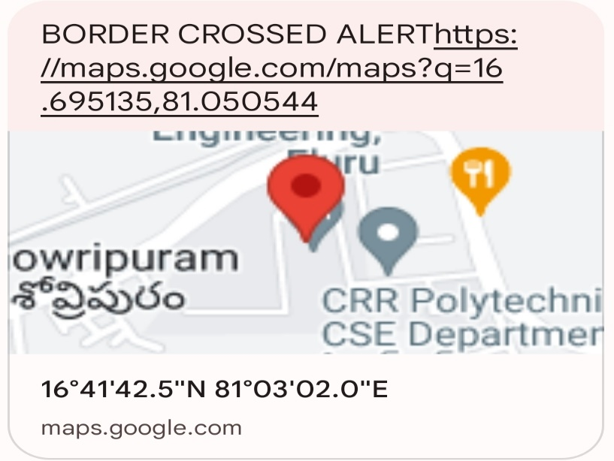
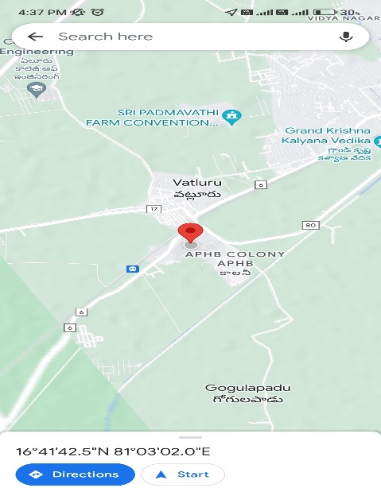
RESULTS
Sends an alert msg with location and the
buzzer makes beep sound alert.
Shows exact location with latitudes and longitudes of the place

Slide 27
ADVANTAGES AND APPLICATIONS
Advantages:
Find the live location of fisherman
Give early alerts at border crossing time
Low cost
Applications:
Boats
Army
Navy boats
Advantages:
Find the live location of fisherman
Give early alerts at border crossing time
Low cost
Applications:
Boats
Army
Navy boats

Slide 28
CONCLUSION
Thus the fishermen can easily identify the national sea borders and therefore prevents them from entering their area. Thus saving their lives and providing good relationship with the neighboring countries. Also, the piracy of ship can be easily brought under control.

Slide 29
REFERENCES
[1] K. Suresh Kumar et. Al, “Design of low cost maritime boundary identification device using GPS system”, International Journal of Engineering Science and Technology Vol. 2(9), 2010, 4665-4672.
[2] M Sivaramaganesh, International journal of innovative research in electrical, electronics, instrumentation and control engineering vol. 2, issue 3, March 2014 .
[3] http://www.thehindu.com/multimedia/dynamic/01689/TH_ 09_GROWING_rev__1689954g
[4] S. Mani Sunder, “Deep sea fishermen patrol system for coastal intruder positioning” Scientific Engineering and Technology (ISSN : 1581)Volume 2 Issue 3, PP : 129
[5] P.Satheesh, “Maritime Border Refuge System [MBR]”, National Conference on Emerging Trends in Computer, Communication & Instrumentation in Strength Security

Slide 30
THANK YOU

